Slide 1
North Yorkshire & Humber
Directors of Informatics Forum
DIGITISING WORKFLOWS AND IMPROVING COMMUNICATON BETWEEN TEAMS IN THE NHS
Ray Wan

Slide 2

Agenda
Overview of the performance challenges and implications to the NHS
Challenges for the Informatics teams
What does ASCOM do and how can they help support your objectives?
Demonstration

Slide 3
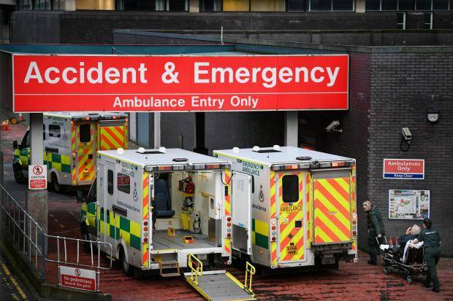
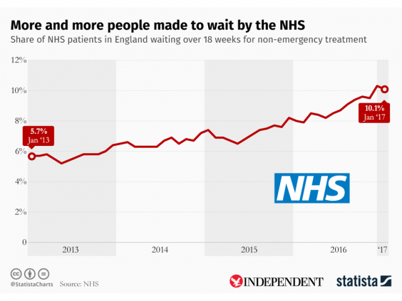
Performance Challenges in the NHS
A&E
‘Waiting time used a barometer for overall performance’ kings fund
    4 hour standard not met since July 2015. Average 85.2%
Planned operations and treatment
    18 week RTT not met since Feb 2016
    Pathways are competing with other hospital demands; admissions, delayed transfers of care and bed occupancy
    Longest waits are in surgical specialities.
    Elective treatment growing by 11% YOY

Slide 4
Performance Challenges in the NHS..continued
CQUIN target examples
  Reducing the impact of serious infections and deteriorating patients
  Reduction of clinically inappropriate antibiotic prescription and consumption.
  Improving the assessment of wounds
  Preventing ill health by risky behaviours such as alcohol and drugs
Local projects;
  Leeds Way – LTHFT Lean management process
  Mid Yorkshire Quality Improvement System
Notes:
Project locally that will help streamline pathways to improve the outcomes

Slide 5

Financial implications
Cancellation of non urgent operations 2nd time £5000 per event
4hr waiting time breach £120 per event
18 week breach £400 per event
CQUIN payments withheld 1.5%
STP payments withheld 1%
Best Practice Tariff conditional payment
  e.g. hip fractures £1124

Slide 6

Telephony and Unified Communication Challenges
Interoperability between systems and devices on the trust infrastructure.
Ensure systems fit for purpose between IT and clinicians
One device for suitable for all forms of communication.
Improving collaboration
Data management and Auditing
Cybersecurity

Slide 7













The Ascom Healthcare Platform
INTEGRATE– Connecting patient devices and hospital information systems to unlock valuable care information
ORCHESTRATE – Filter, prioritise and extend the flow of information for speedier informed decisions
ENABLE – Enhance communication and information among mobile care teams
Notes:
5000 systems in the hospital of which 70% do not communicate with one another. That data is consolidated into a meaningful format.
Mission critical information is delivered for the carer

Slide 8





Common workflow problems
H
Theatre Productivity
Coordinating Emergency Care
A&E
Hospital at Night
Deteriorating Patient
Nurse & Doctor Rounds
Fractures
‘Improving workflow will increase economies of flow ‘

Slide 9

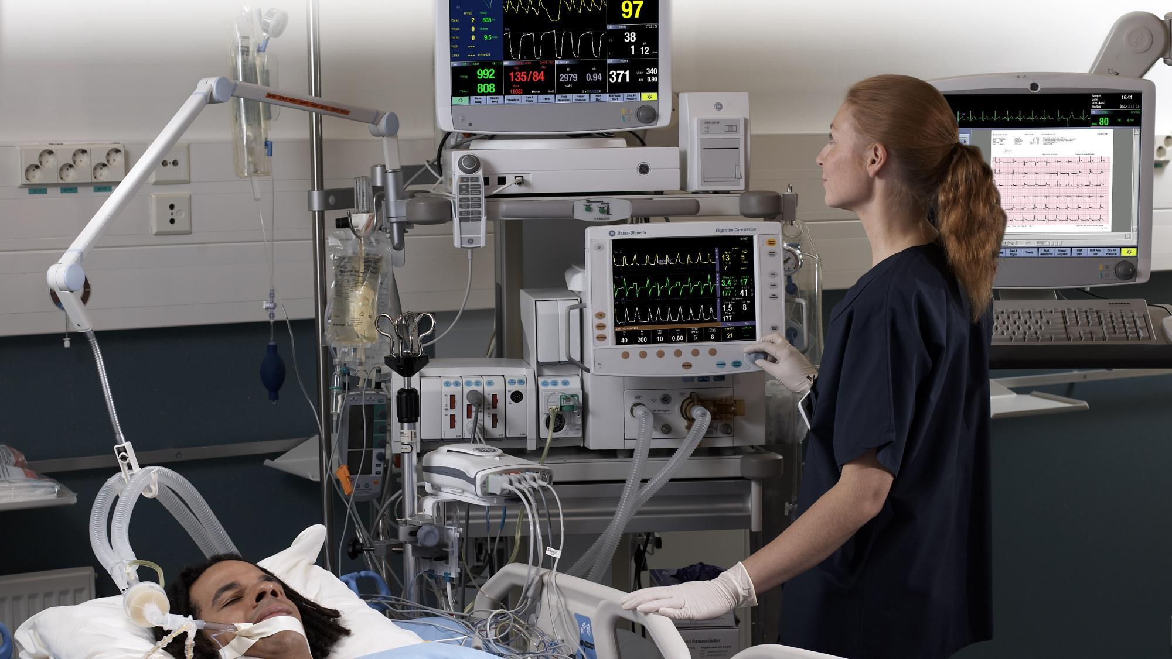





Ascom Healthcare Platform- Integration
Designed as an open and technology agnostic solution.
Allows multi- dimensional approach to clinical and digital information workflows.
Clinical care solutions become more insightful, accessible and actionable.
Extended HL-7 Protocols to the trusts EPR and drivers to care devices. Data is captured and audited.
EHR
Transfer
Integration
Storage
Auditing
Notes:
Over 5000 systems in the NHS . Fragmented data and limited connectivity. Integrate with over 200 vendors allowing Unified connectivity
allows NHS a new approach to existing workflows
The information is digitally captured consolidated and delivered in a meaningful way
ICU – complex environment. Integration of information direct to trusts EPR.

Slide 10
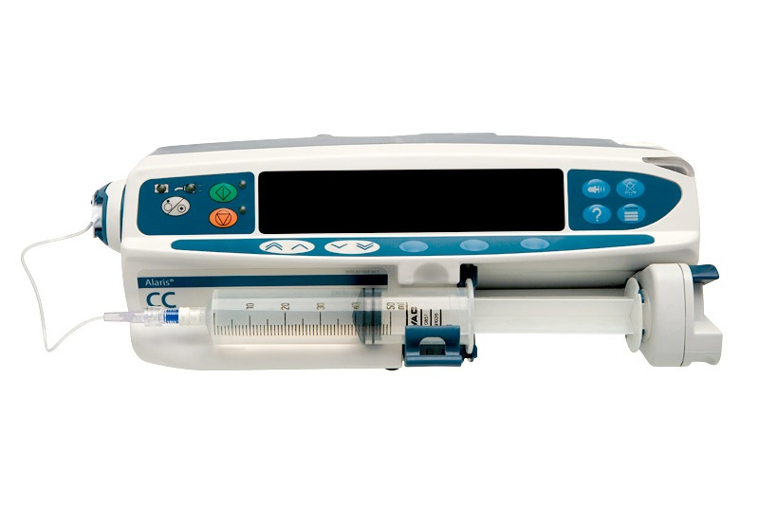
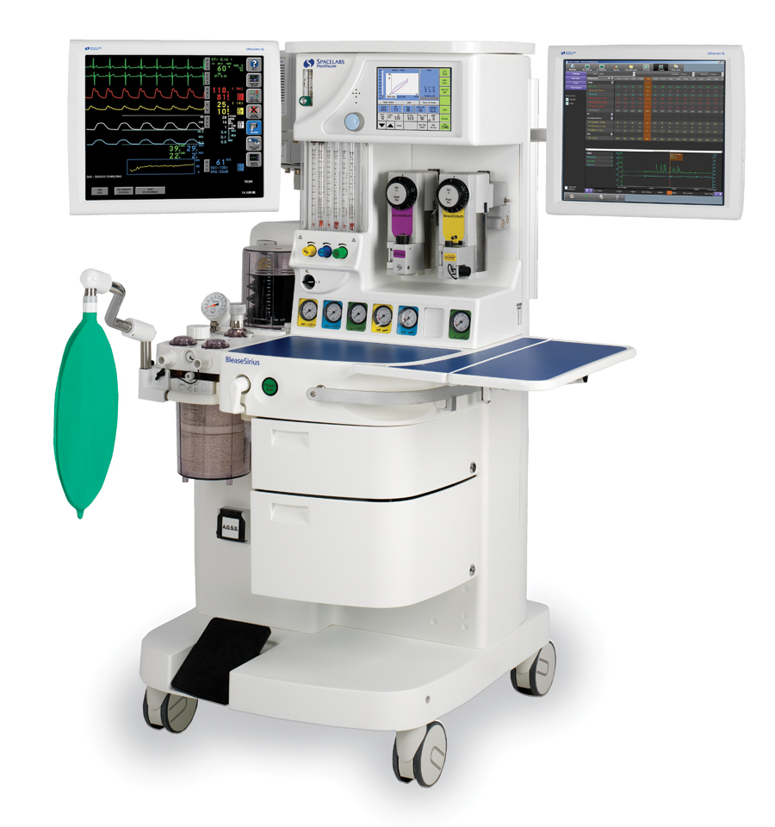
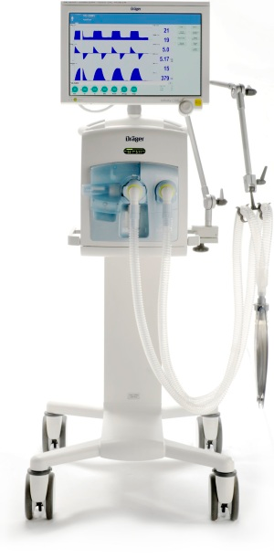
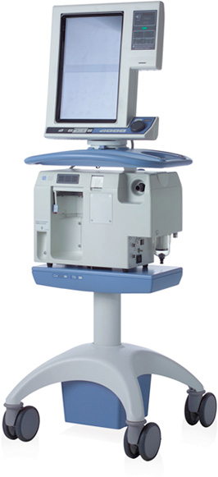

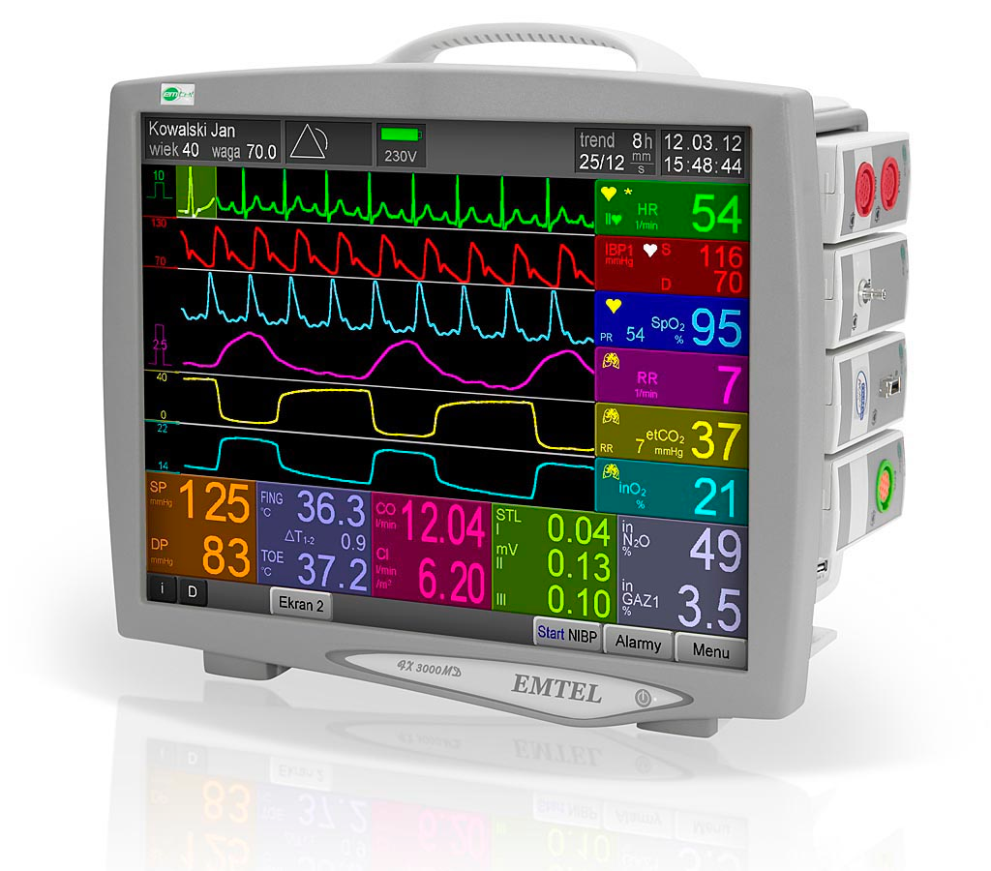
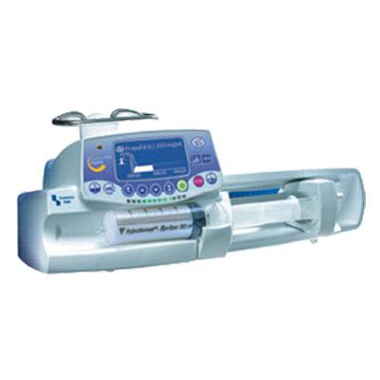
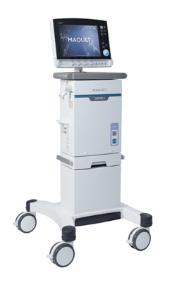

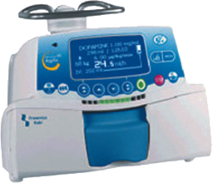
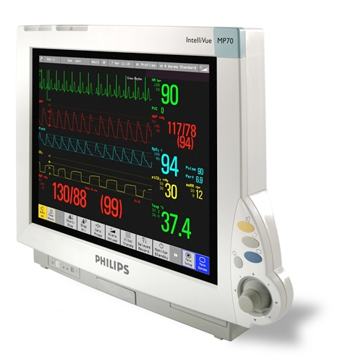
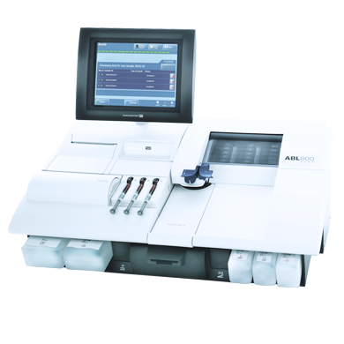










Driver definition
Driver
Ethernet
Hundreds of devices
Driver
Driver
Serial
Many physical interfaces
Driver
Driver
Driver
ASCOM
Driver
Driver
Driver
Hundreds of different
communication protocols and versions
Notes:
Ventilators, dialysis machines, endoscopy stacks, anaesthetic machines
Over 200 vendors that we can collaborate with full interoperability reports

Slide 11
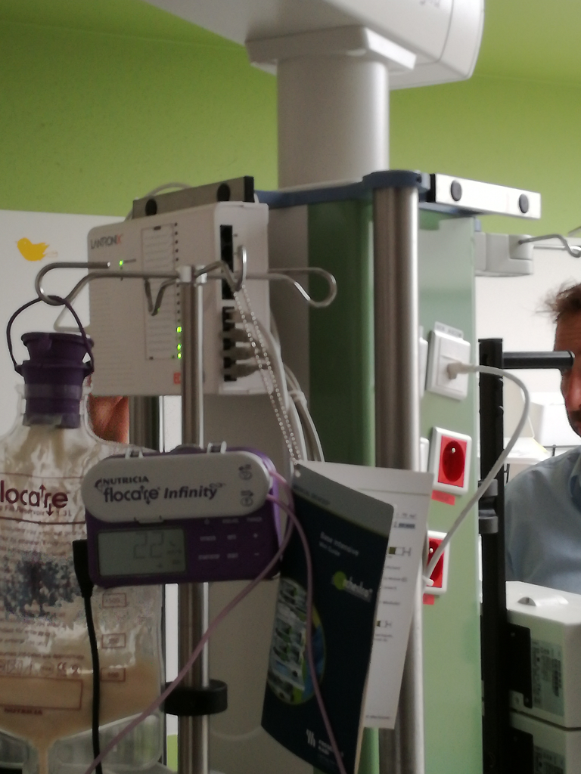
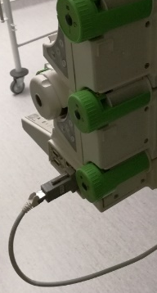
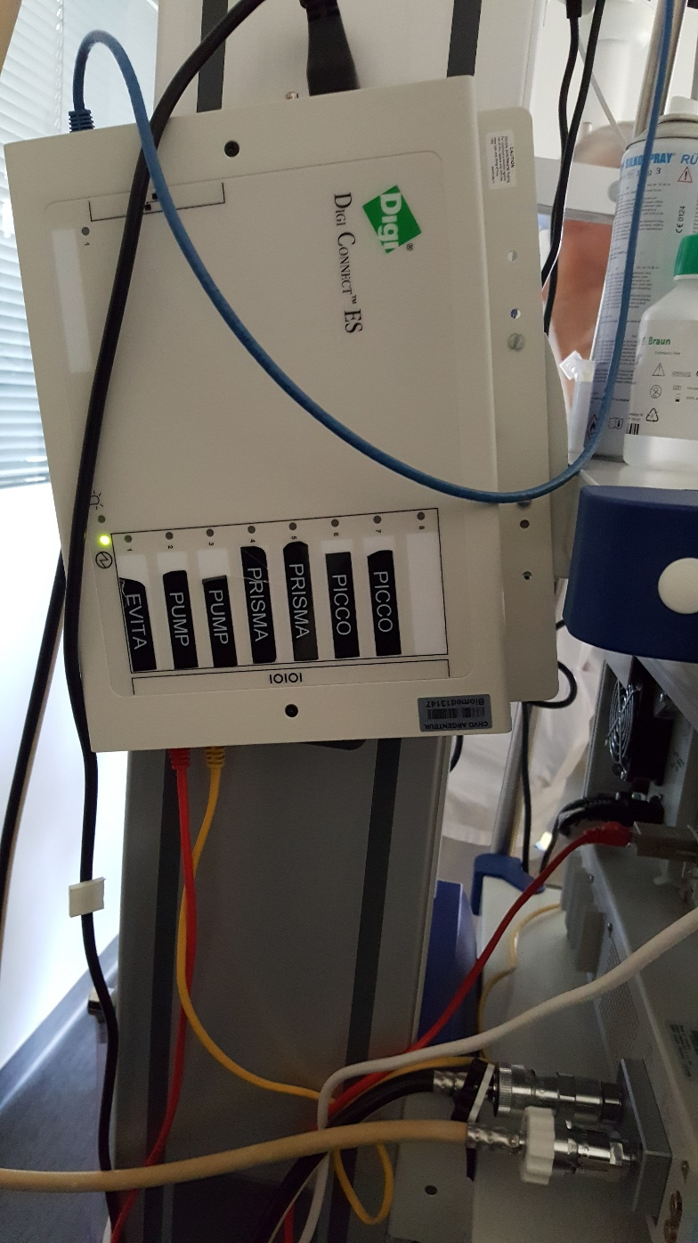
Port Servers - A real installation

Slide 12
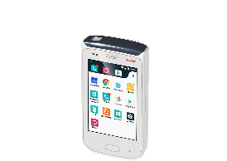
ORCHESTRATE
Notes:
Rapid response team dashboard
Busy to ;look at the dashboard unless they have been paged.
Specific groups and not to outreach eg sepsis nurse for ED, Registrars, or Paeds nurse and Paeds consultant on call…..escalation pathway for matron to name but a few.
In patient or acute – snr sister, matron and cons
Outreach used appropriately.

Slide 13
Orchestration Software
Notes:
ASCOM will consult and discuss what is needed to meet your objectives and test pilot the system

Slide 14
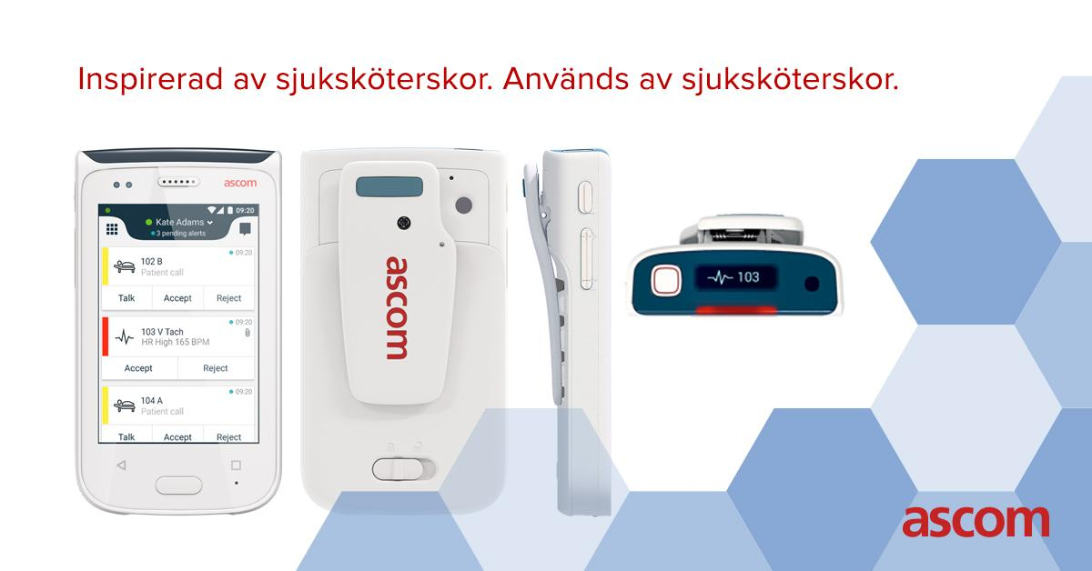
The Enabling: MYCO 2 – Meeting the demands of the hospital
Dedicated Built-for-Healthcare Smartphone
Notes:
Enterprise handset dedicated for the healthcare setting.

Slide 15


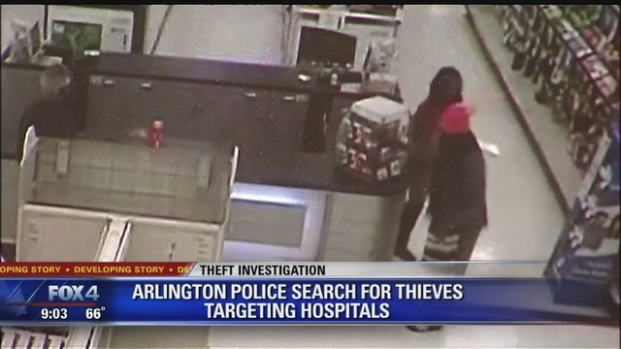
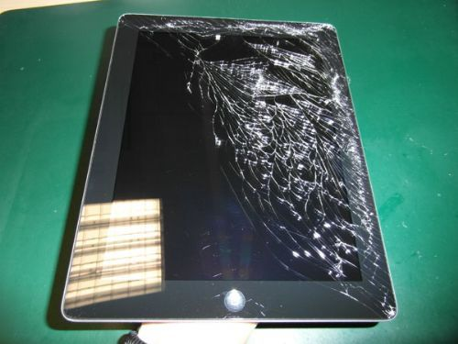
Your colleagues are reviewing the handsets…
Bolton
Huddersfield
Derby
Chesterfield
Middlesborough
Gateshead

Slide 16
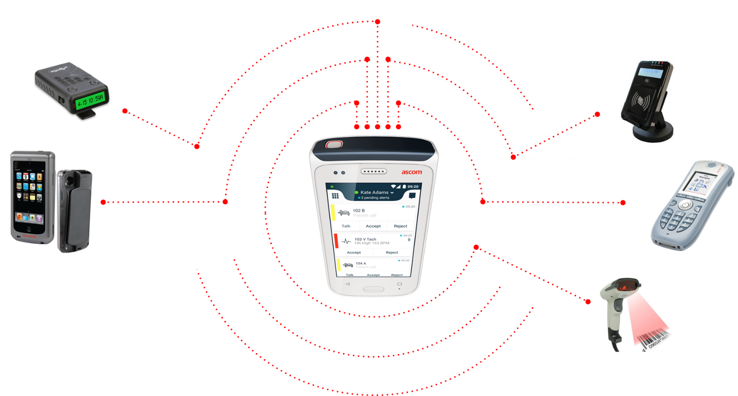




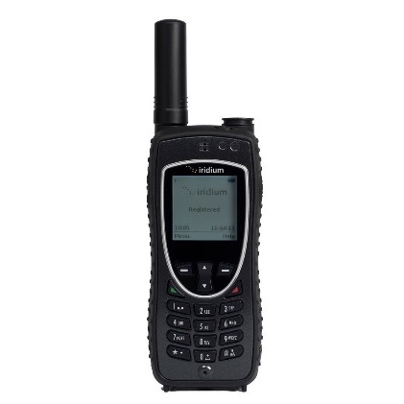


A Smart Consolidation Of Devices
Two Way Pager
NFC reader
Wireless
Telephone
Robust Smart Device
Honeywell™ Barcode Scanner
DECT handset
Notes:
Purpose built hardware. Ruggedised and Splash proof – infection control
Top display, Alarm button, Carry Clip
Smart device apps - Ascom messaging is priority – intuitive task window, easy to understand priority

Slide 17
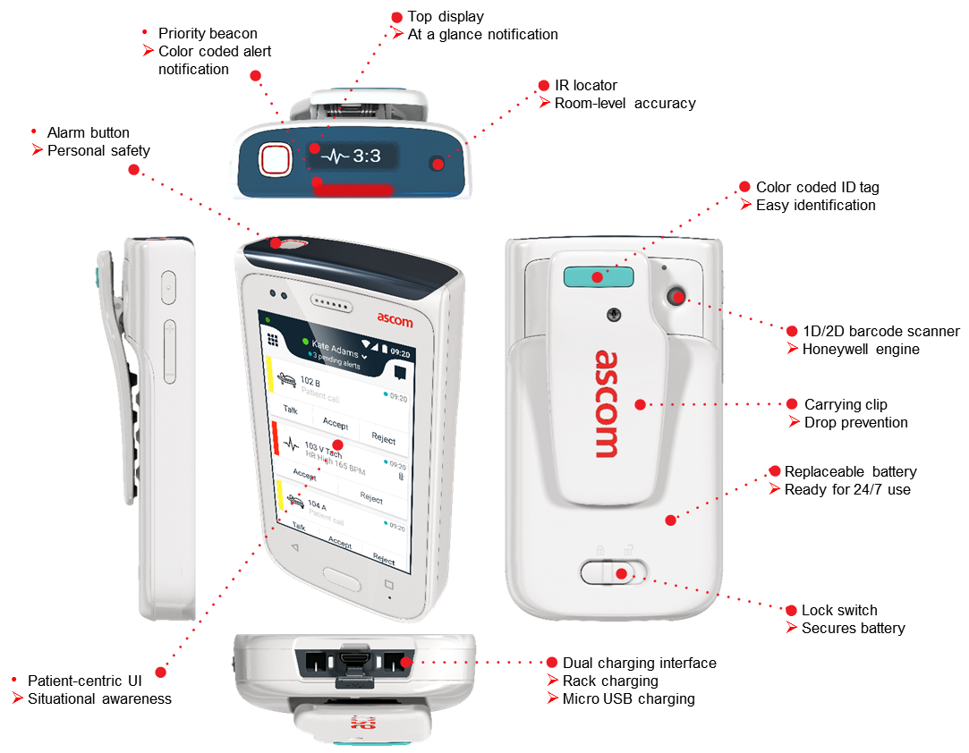
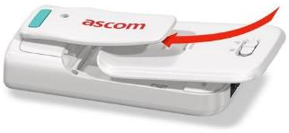
Built to last – increasing return on investment
Ascom Myco is built for longevity – even when handed over shift after shift - 24/7 by 365.
Designed to reduce repair and replacement costs.
Water and Dust Proof (IP54 standard)
Robust and durable – Designed for the healthcare setting.
Replaceable battery
Disinfect-ready
Notes:
Unlike commercial phones, designed for the healthcare.

Slide 18
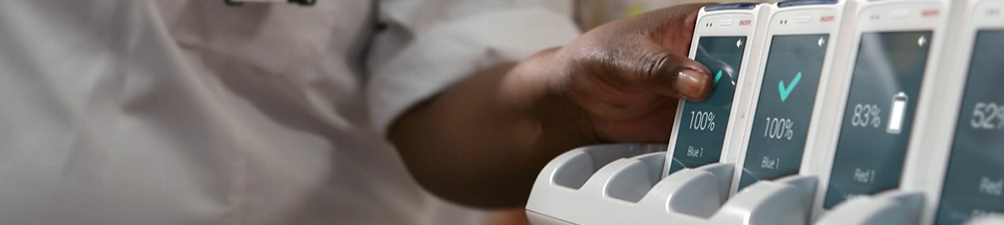
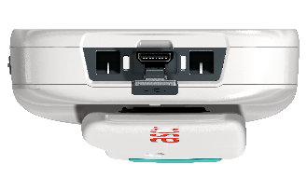
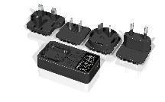

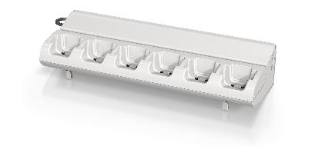
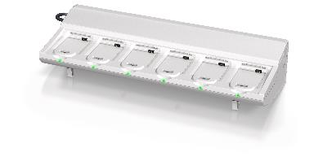
Maximizing power and charging efficiency
Dual charging interface
Supports rack charging and desktop charging via micro USB.
Configurable “in-charger” behavior.
  Auto mute, logout, data wipe, etc.
Available charging options
Wall mountable - 6 bay handset charger.
Wall mountable - 6 bay battery charger.
Micro USB charger with international plugs.

Slide 19

The ASCOM Healthcare platform
Connecting staff with mission – critical information.

Slide 20
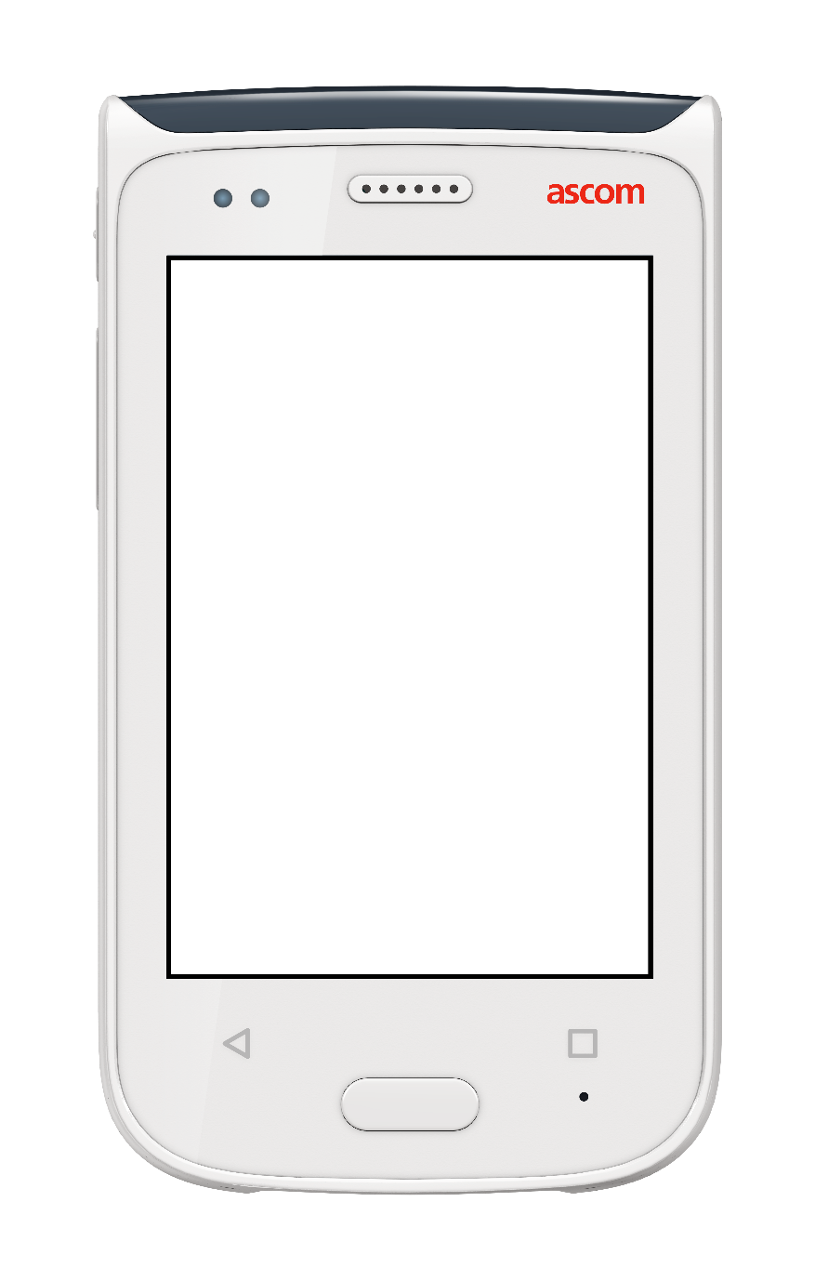
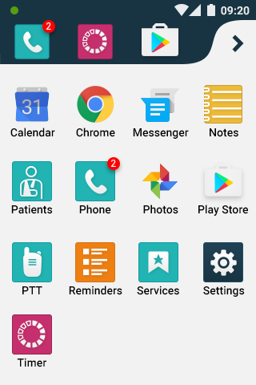
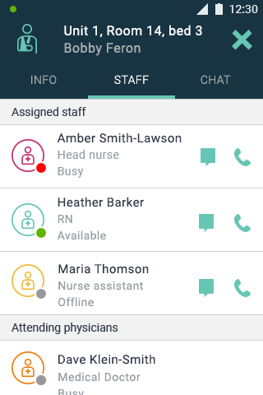
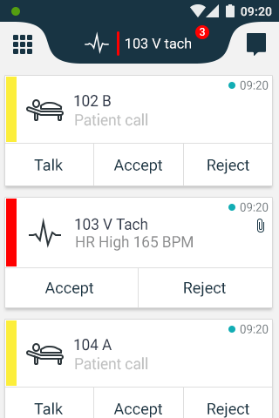
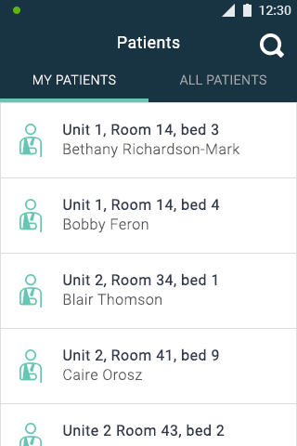
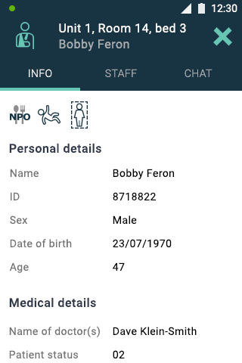
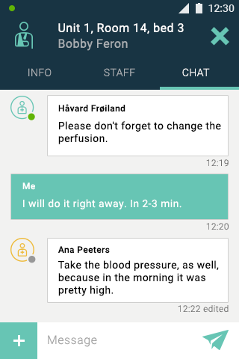
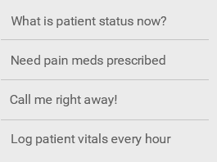

Patient-centric staff collaboration NEW VERSION
Patient-centric staff collaboration
Staff Tab
Care team assignments for a specific patient
Patients
Option to view “MY PATIENTS” or “ALL PATIENTS” in the ward
Info Tab
Access patient health info including precautions, allergies, assigned doctors, and more
Select patient to view EMR patient health info
Chat Tab
View message exchange for specific patient discussions
Select “Patients” app in menu to get started
Initiate message or phone call to care team member
Compose new message using predefined text content
From Myco home screen, swipe right
Slide show mode
required for viewing
Return to Myco home screen
ASCOM WORKFLOW PRESENTATION | RAY WAN | MAR 2018 | ©ASCOM

Slide 21
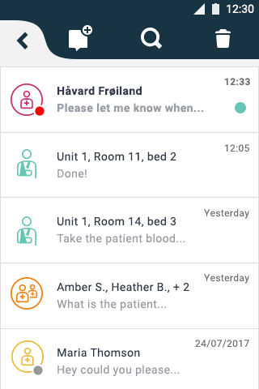
Patient-centric staff collaboration
Chats Screen
Overview of all
ongoing chats
Initiate new message
by searching staff directory
1-to-1 chat message
From Myco home screen, swipe left to view Chat messages
Chat feeds for assigned patients
Slide show mode
required for viewing

Slide 22








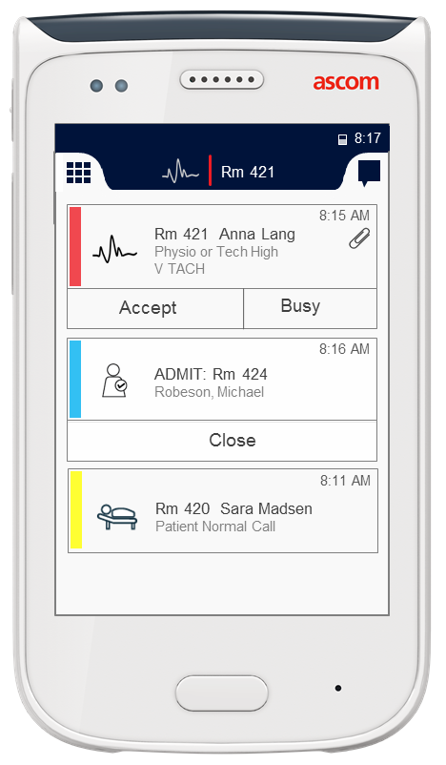



















Closing Information Gaps
+ ?
Temperature
Alarms
Bed
Management
X-ray
+ ?
Fire Alarm
Portering
+ ?
PAS
EPR
Monitoring
+ ?
Building
Management
+ ?
Crash Call
Pharmacy
+ ?
Security
Panic alarm
+ ?
Bloods
Referrals
Nurse call
+ ?
Asset
Management
+ ?
H@N Task
Management
NEWS
Telephony
Messaging
Barcode
scanning
Directory
Apps
Alerts
Notes:
With integration - Ascom Myco becomes the your information hub!!
Blue tiles – technology available at the point of care. 3rd Party apps on a device fit for purpose are closing information gaps.
Clinical in brown
Crash call - user alarm button or alarm agent – we know who’s responding.
Electronic observations – timely intervention – alerts and barcode scanning.
H@N referrral can build in specific ward phone numbers from directory.
Anywhere where there is information that you would need to go or fetch from someone or some system where you need to log in and check. Ascom deliver, faster, informed dcisions.
Red – other time critical information in hosital – estates, catering, security, porters.
Integrations develop with the digital development of the hospital, panels added as the hospital grows digitally – modular bolt ons.

Slide 23
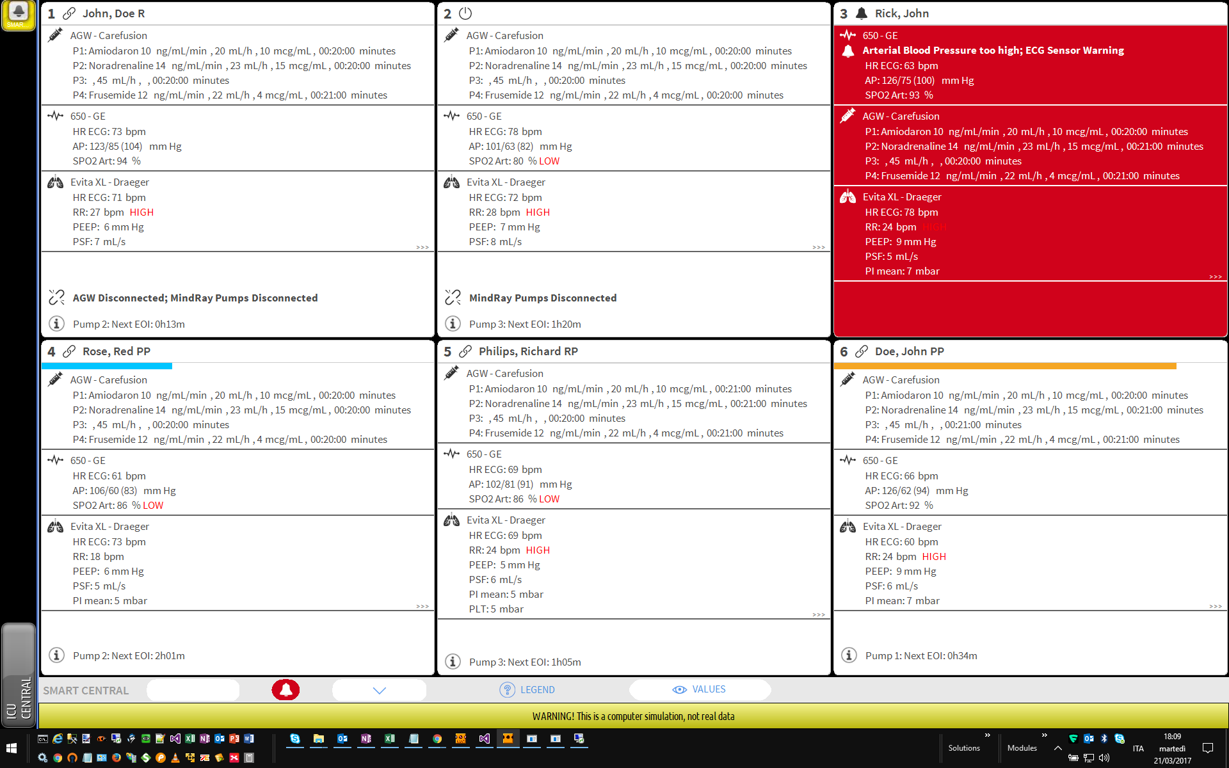
Digistat Smart Central – Connected devices
Notes:
Patient monitors, infusion pumps and ventilators summerised in a meaningful manner for the cl

Slide 24
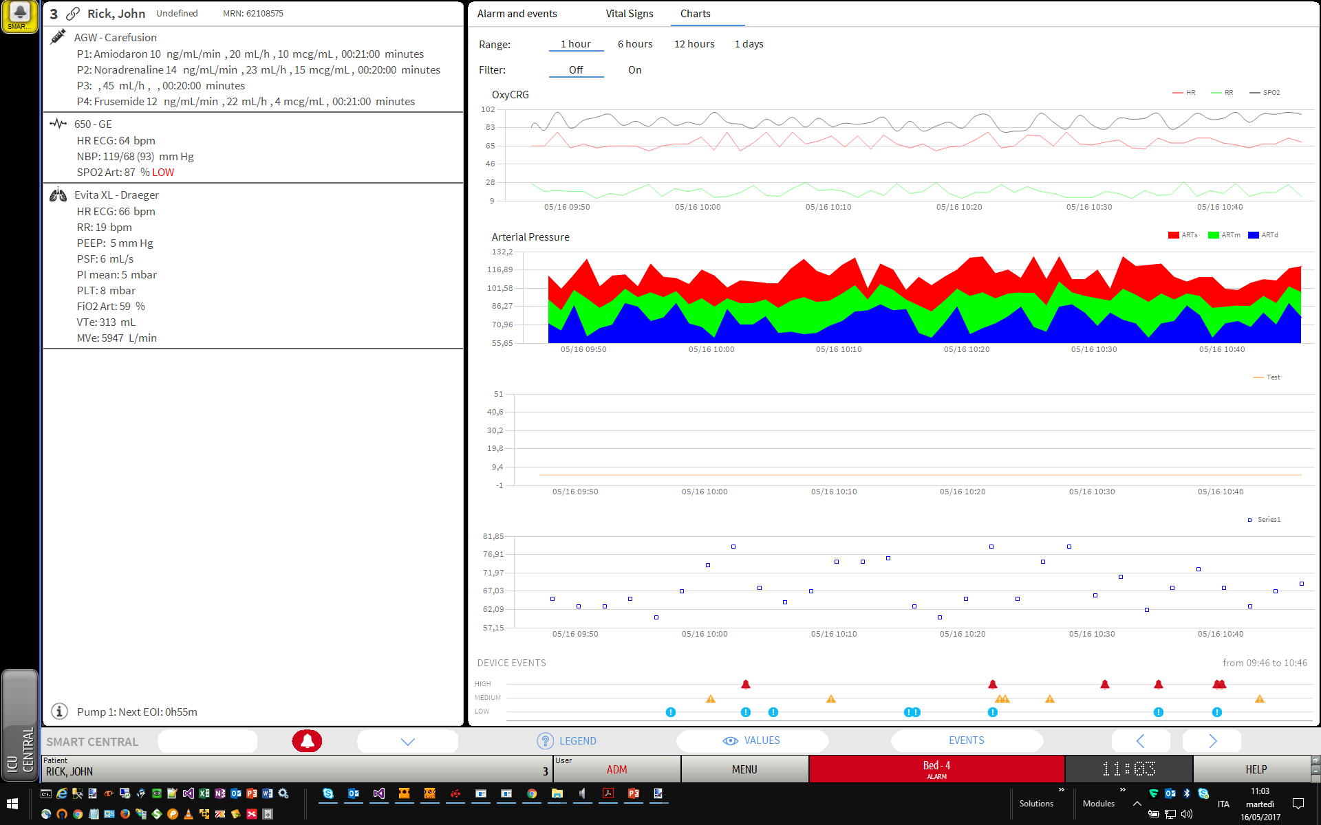
Smart Central- Dashboard
Notes:
(typical customer, customer stakeholders, major arguments, average sales cycle)

Slide 25
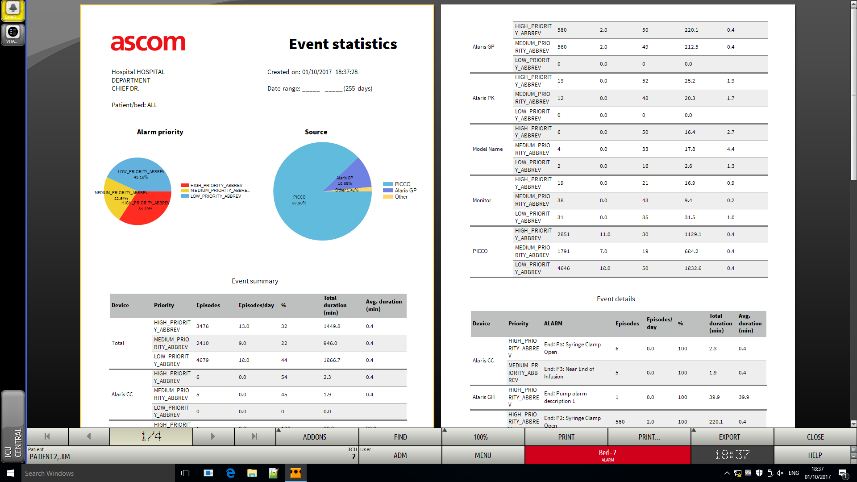
Smart Central - Dashboard
Notes:
(typical customer, customer stakeholders, major arguments, average sales cycle)

Slide 26
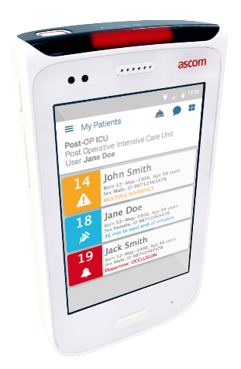
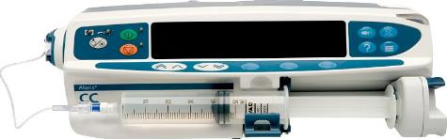
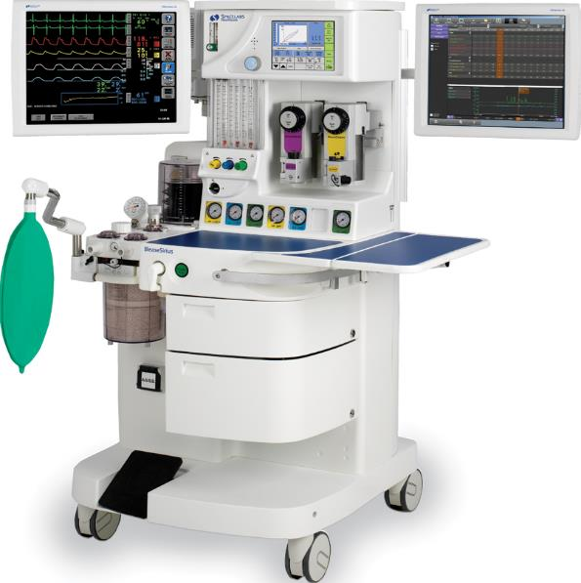
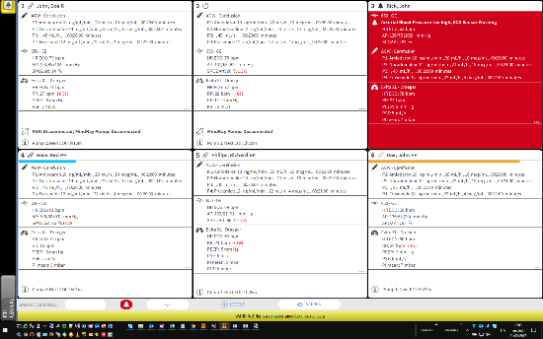
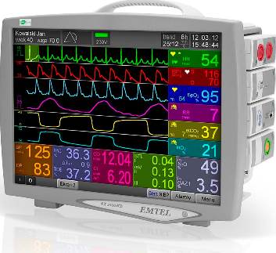
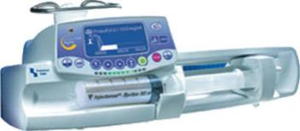
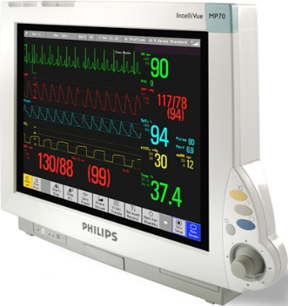
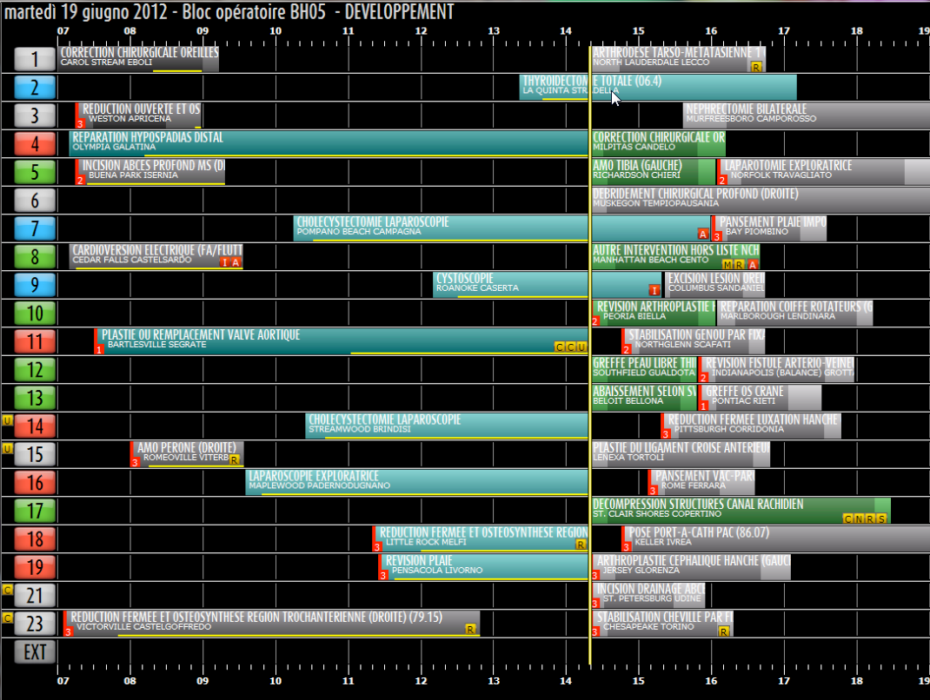

ASCOM platform
Connectivity
Alarm Management
Mobility
Asset Management
Surgical/Anesthesia
Acute Care
Notes:
Mobility handset is part of a bigger platform. We have the software to capture data that is insightful, accessible and actionable.
We also have planning tools which are dedicated plugins for the trusts existing EPR

Slide 27

Ascom Installed Bases
Royal Free Hospital and Chase Farm
South London and Maudsley Mental Health
Chelsea and Westminister Hospital
Wolverhampton Hospital
NHS Greater Glasgow and Clyde
NHS Fife
NHS Grampian

Slide 28

Organisational benefits
Better scheduling, utilisation of staff and patients – INCREASED PATIENT THROUGHPUT AND WORKFLOW EFFICIENCY.
Greater visibility of patient status and journey from admission to discharge – REDUCED DELAYS IN TRANSFER and LENGTH OF STAYS.
Data captured – CONTINUOUS QUALITY IMPROVEMENT AND BETTER PATIENT EXPERIENCE.
Information rich for frontline staff – DELIVER BETTER QUALITY OF CARE FOR PATIENTS.
Avoids ‘double documentation’ – IMPROVED PRODUCTIVITY FOR DEPARTMENTS.

Slide 29
Informatics benefits
Consolidation of communication devices to one – money saved
Interoperability between systems and devices to the trust infrastructure. - no additional infrastructure.
Uses only the hospital security certificates. - cybersecurity is intact.
Customisable platform – The clinical department drives the concept.
Cost – managed service options and additional savings based on size of project.

Slide 30

Thank you
Name Name
Ray Wan
Ascom
Mobile: 07879 773897
raymond.wan@ascom.com
www.ascom.com

Slide 31












Example - new customer
Events
RS232/Ethernet
Events
Cardiomax
Ascom Unite
Connectivity Manager
Patient Monitor
Data/events
RS232
RS232
Data/events
Data/events
Driver
RS232/Ethernet
Ventilator
Data/events
RS232/Ethernet
Data/events
Infusion Pumps
Other devices
Digistat Server/VM
HL7 outbound data
CRRT (Dialysis)
EMR, CDSS, PDMS

Slide 32


Driver list
Analysis of documentation
Risk analysis
Design
Development
Verification
Validation
Release
Surveillance
Notes:
RISK ANALYSIS To verify if connectionc na interfer with medical devices, for example disable the remote control
VERIFICATION in the lab to verificate that everything is compliant with the tech specs provided
VALIDATION at customer side to validate taht the result is compliant with teh request

Slide 33

Smart Central
Notes:
(typical customer, customer stakeholders, major arguments, average sales cycle)

Slide 34

Smart Central- Dashboard
Notes:
(typical customer, customer stakeholders, major arguments, average sales cycle)

Slide 35
Smart Central- Dashboard
Notes:
(typical customer, customer stakeholders, major arguments, average sales cycle)

Slide 36



Enable better communication with fewer work interruptions
Leverage Clinical Systems
Wireless/ DECT Technology
Software Integration & Transfer
Advanced Alerts and interactive messages
Communication System
Voice
Data Storage
Clinical Chat Messages

